Slide 1


SDPBRN Postgraduate Training Day
Examples of research into quality improvement within health and social care
Scottish Improvement Science
Collaborating Centre
Dr Madalina Toma (Research Fellow) and Gill Milner (Workstream facilitator)
21st of June 2018

Slide 2


Scottish Improvement Science Collaborating Centre (SISCC)
Strengthening the evidence base for improving the quality of care sustainably and at scale
@EBImprovement
#SISCC
http://siscc.dundee.ac.uk

Slide 3
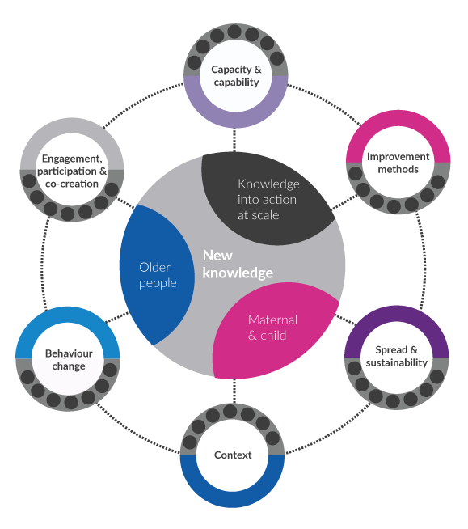

Slide 4



@toma_madalina84
m.t.toma@dundee.ac.uk
Achieving a balanced accounting of quality improvement impact;
A qualitative analysis of individual and group interviews,
narrative review and modified consensus study
Dr Madalina Toma, Research Fellow

Slide 5
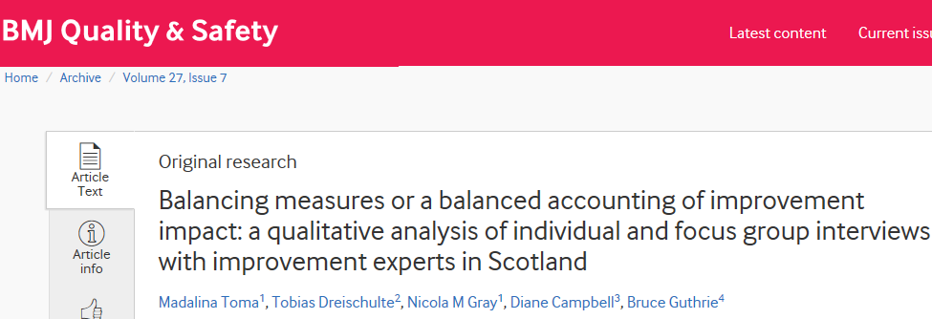
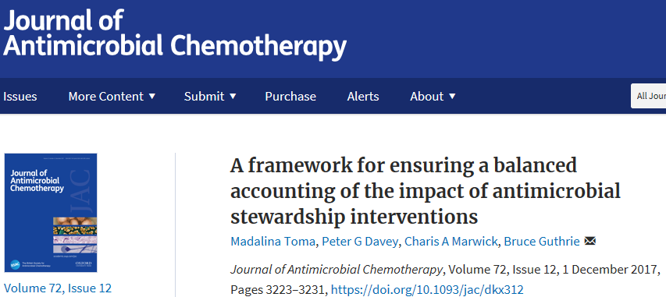
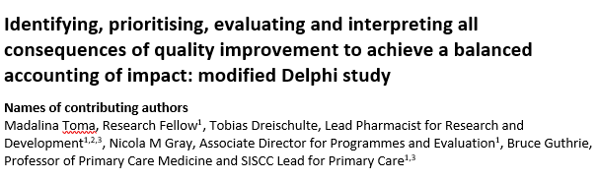

Slide 6
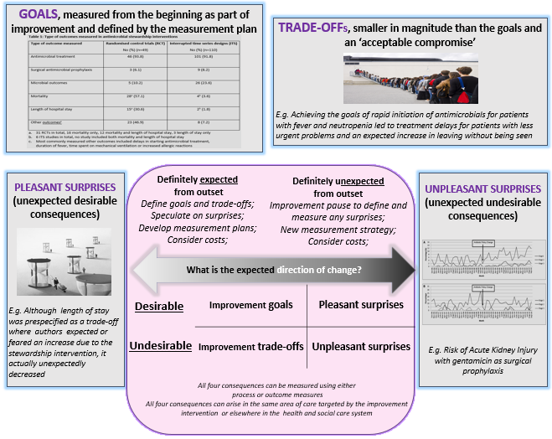

Slide 7
Consensus about the process of evaluating all unintended consequences
Identifying potential consequences of improvement
Prioritising which identified consequences to systematically evaluate
Undertaking appropriate evaluation for any identified consequences
Interpreting the emerging data to inform
further action

Slide 8

Consensus about the relative importance of WHO should be involved in all four stages
Clinical teams-identification, evaluation and interpretation
Managers-evaluation Patients-identification
Improvement advisors-interpretation

Slide 9
Key message
Improvement measurement is usually focused on measuring intended goals, with minimal consideration of other unintended consequences.
Improvers and leaders should seek a balanced accounting of all consequences of improvement across the life of an improvement programme, including a careful consideration of potential trade-offs from the outset and deliberately pausing after implementation to identify additional pleasant and/or unpleasant surprises, decide on the importance of introducing new measures, quantitatively or qualitatively evaluate any surprises and interpret the emerging data to inform further action.

Slide 10
Selected References
Davey P, Marwick CA, Scott CL et al. Interventions to improve antibiotic prescribing practices for hospital inpatients. Cochrane Database Syst Rev 2017;2. DOI: 10.1002/14651858.CD003543.pub4
Toma M, Dreischulte T, Gray NM, et al. Balancing measures or a balanced accounting of improvement impact: a qualitative analysis of individual and focus group interviews with improvement experts in Scotland, BMJ Qual Saf Published Online First: 21 October 2017. DOI: 10.1136/bmjqs-2017-006554
Toma M, Davey PG, Marwick CA, et al. A framework for ensuring a balanced accounting of the impact of antimicrobial stewardship interventions, J Antimicrob Chemother 2017:72,3223-31.DOI 10.1093/jac/dkx312
Toma M, Dreischulte T, Gray NM, et al. Achieving a balanced accounting of impact through identifying, evaluating and interpreting all consequences of quality improvement: modified Delphi study, Submitted to BMJ Open April 2018

Slide 11

@EBImprovement
#SISCCMCH
Evidence into Practice: Breastfeeding and Kangaroo skin-to-skin care for babies & families in neonatal units.
Gill Milner

Slide 12
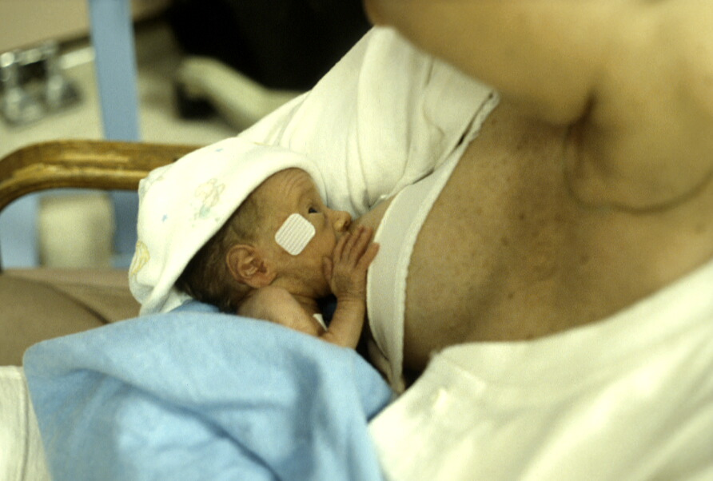
Notes:
The focus of the project I lead on is to improve breastfeeding

Slide 13
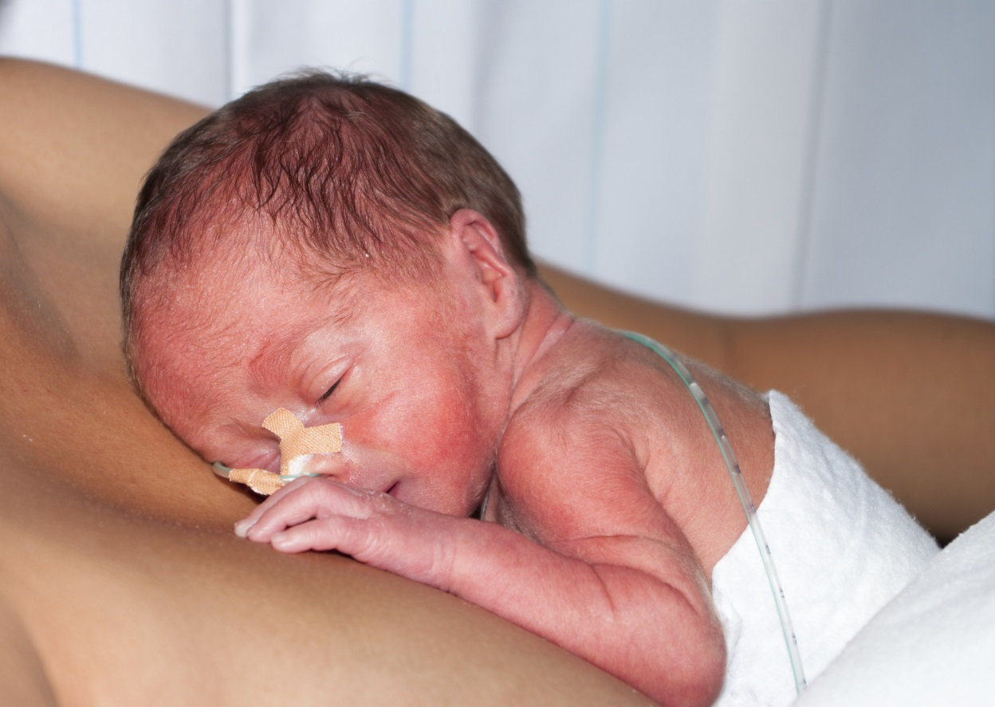
Notes:
And Kangaroo in NNU’s in Scotland

Slide 14


What works in large-scale change?
Improving maternal and infant health and care: at admission in labour and promoting attachment and breastfeeding in neonatal units
Evidence into Practice consultations
A report of region-wide consultations in Yorkshire and the Humber region June 2011
Conducted by the Maternal and Infant Health and Care theme of the Yorkshire and the Humber Health Innovation and Education Cluster (HIEC)
Cath Burke Helen Spiby Alison McFadden
Georgina Lessing-Turner
Gill Herbert James Thomas Mary J Renfrew
Image © magnetofilms.com
Mother and Infant Research Unit, Department of Health Sciences,
University of York, YORK, YO10 5DD
http://yhhiec.org.uk/wp-content/uploads/2011/06/11060109_Master_EiP_Report.pdf
http://yhhiec.org.uk/
Notes:
So we all the importance and benefits of skin to skin kangaroo care and of breastfeeding for premature baby both physical and psychosocial but how are we going to improve the current situation in the units in Scotland… This work is not about generating yet more evidence on the benefits we know all that and you more than anyone can re-guritate all that, this is about shifting that knowledge into practice and really embedding it and shifting those breastfeeding rates and outcomes for babies.
The work of Professor Mary Renfrew in York and Humberside showed that these practices can be implemented successfully and at scale through adopting a Evidence into Practice approach, and we have taken this approach and are attempting to mimic it here in Scotland. So I will explain a little of how it works….

Slide 15

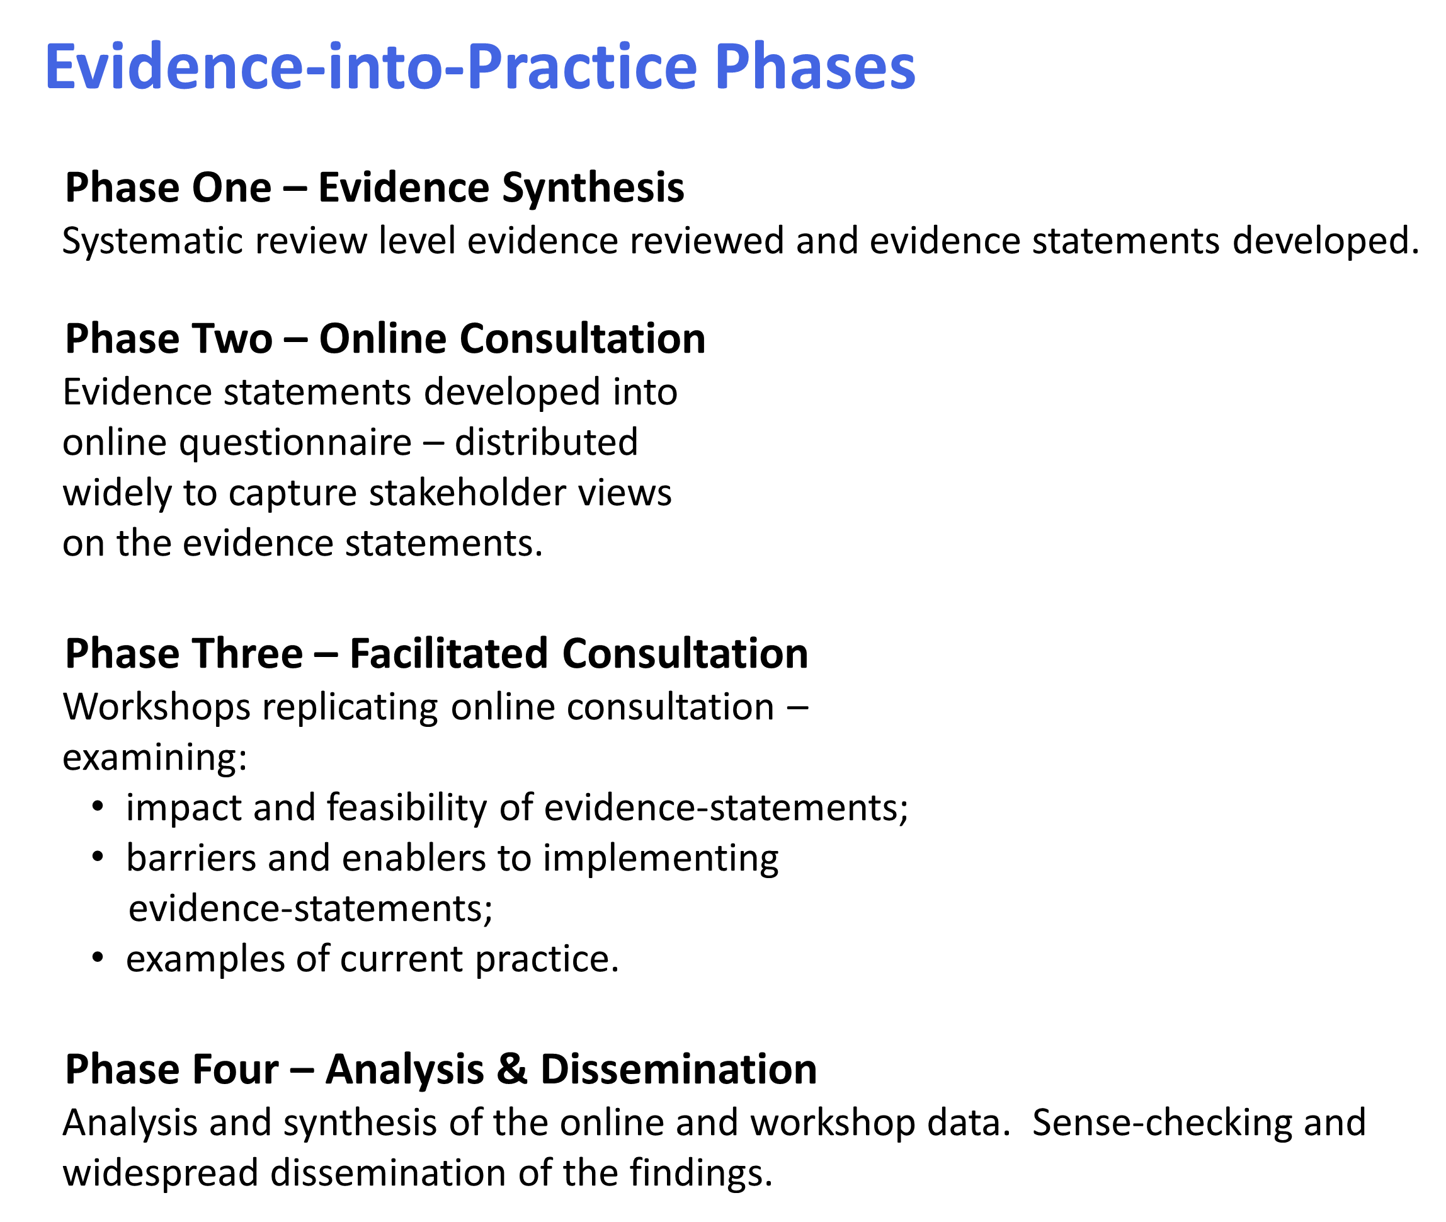
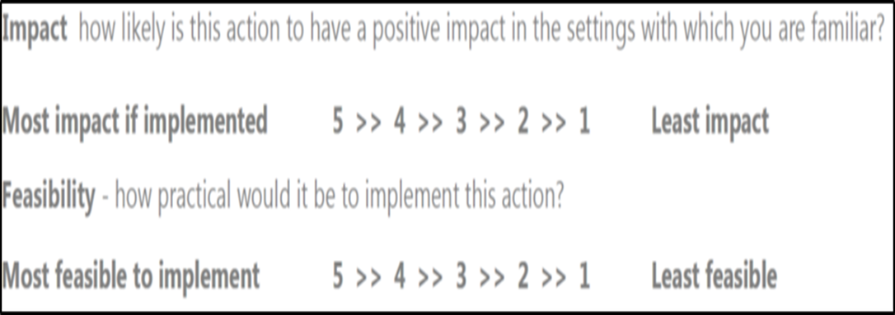
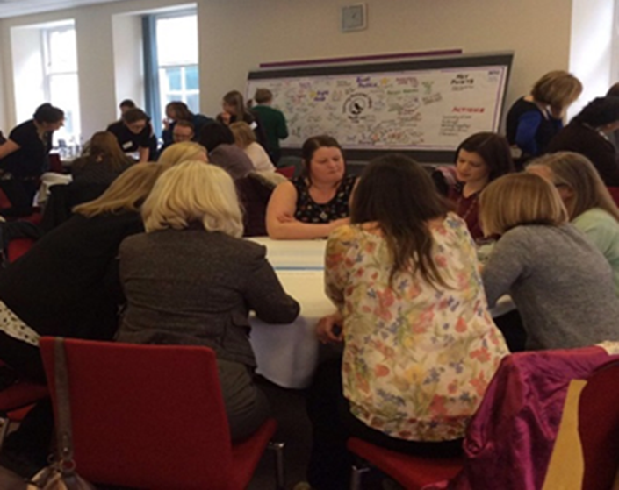
Evidence into Practice (EiP) Approach
Notes:
We are taking an Evidence into Practice Approach to improve outcomes , the approach is made up of four phases which I will now briefly describe and am delighted that some of you have been involved in these phases.

Slide 16




Evidence statement:
“An individualised discharge plan for breastfeeding mothers with follow-up telephone calls maintains mothers confidence in breastfeeding and provides reassurance.”
Notes:
So I am now going to look a bit closer at the phases and what happened.
So during the evidence review there were evidence based interventions/statements extracted and from this an online questionnaire went out far and wide, responses were initially poor and we learned a lot about how we need to reach neonatal staff.
Staff were asked about the impact of embedding that evidence, how feasible it would be in reality and whether or what they were doing in relation to that evidence.

Slide 17

Scottish Improvement Science
Collaborating Centre
Regional Workshops
North of Scotland
Aberdeen 24th April 2017
South East & Tayside
Edinburgh 19th April 2017
West of Scotland
Glasgow 29th March 2017
Notes:
We then had national consultations - explain

Slide 18

Consultation Exercise 2 – Edinburgh MCH Workshop 19th April 2017
Scottish Improvement Science Collaborating Centre
Evidence Statements 1-4 | Barriers | Strategies & Bright Ideas | Best Practice Examples
Daily kangaroo skin-to-skin contact with mothers (ranging from 10 mins up to 2 hours) for clinically stable very low birthweight infants (under 1,500g) increases the duration of any breastfeeding at discharge and up to one month after.
Any intermittent kangaroo skin-to-skin contact with mothers (of variable duration and frequency) is associated with an increase in any breastfeeding from discharge from NICU until 1-2 months follow up in stabilised infants born under 2,500g.
Any duration of daily kangaroo skin-to-skin contact with mothers that promotes mother-infant interaction and touch results in mothers showing better adaptation to infant cues, better perception of their infant, less anxiety, a greater sense of competence with their infant and more sensitivity towards the infant.
Intermittent kangaroo skin-to-skin contact with mothers is associated with an increase in mother-infant parent-baby attachment at 3 months follow up.
Notes:
Insert road map – aim is to recognise the difference between the evidence and best practice

Slide 19
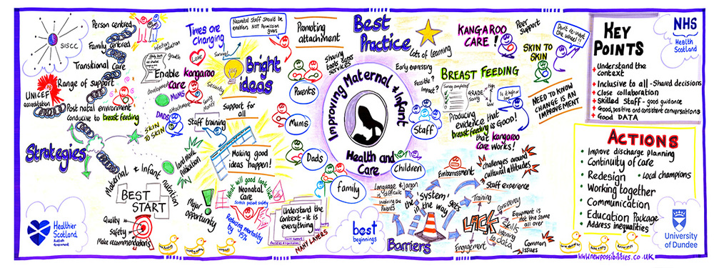
Notes:
We had a live illustrator to also capture valuable data.

Slide 20


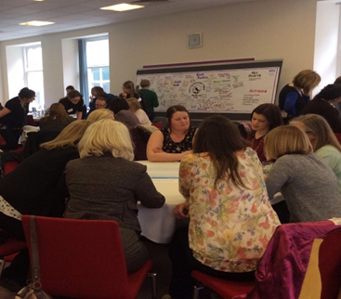



Best Practice
Local Improvement Ideas
Impact / Feasibility
3 Workshops
Online Questionnaire
Analysis
(May/ June)
Blue print /
Road map
Educational / skill needs
Local Priorities
Local Improvement Support
Notes:
So this is what the situation looks like now!

Slide 21



Dissemination
How?
& Who?
Notes:
So going forwards it is important to SISCC and to the integrity of the project in terms of co-creation that we are responsive to what units want that we able to spread the knowledge of the project and the findings to others, those who attended the workshops were keen that others had the opportunity to listen and to the findings and comment and enjoy some the momentum that they had.
How you use and action the data will be up to the units and SISCC have provided some action planning tools around this ,access to the films to make sure everyone is bought in and how you might break the evidence down to embed the actions you suggested at the consultations.
We have been very careful that the work is absolutely seamless and joined up with all the agenda’ s currently underway in NNU’s including BFI accreditation, achievement of recommendation 43 of the maternal and neonatal review and those going for the their BLISS charter recommendation. The intelligence we have gathered and the real hands on opinions of those involved in front line services in this project is absolutely key to driving this forward

Slide 22

Change the world
Notes:
We are not suggesting you change the world, the evidence is about small steps having big ripples and ensuring that the changes we make have a robust evidence base and are not based on just opinion and that we change the things that the evidence tells us make a difference and really look at how we can sustain these changes so they are not person dependant or fashionable but rather just the way we do things!
There is exciting times in neonatal units just now and it feels in terms of these interventions that projects like this help to join the dots and through working together, collaboration and will we can make changes which will ultimately impact positively on those families within our care.

Slide 23
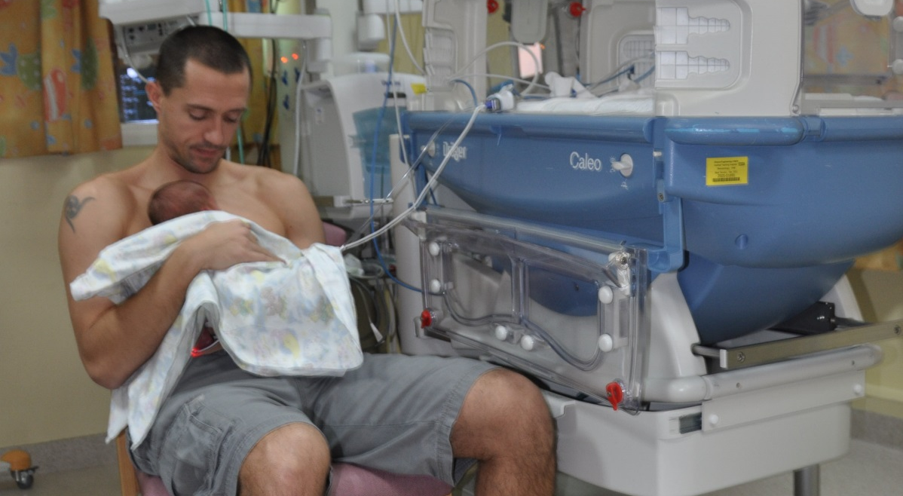
Working together to make a difference
Thanks for listening !

