Slide 1



Clinical Effectiveness Workstream
SDPBRN Postgraduate Training Day
Thursday, 21 June 2018
Qualitative Analysis
Heather Cassie

Slide 2
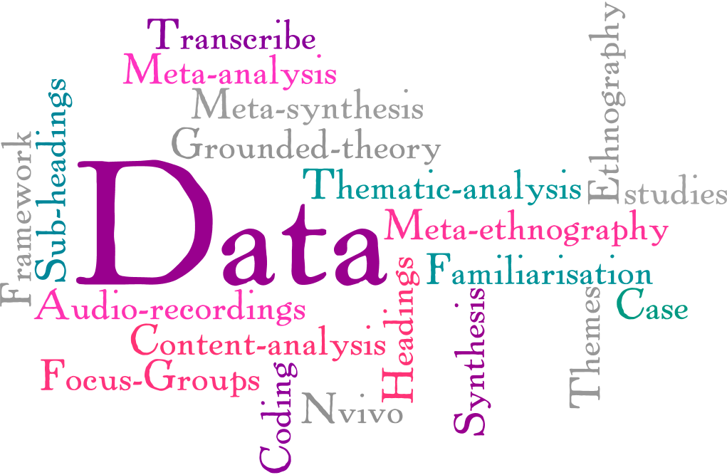

Slide 3

Presentation Overview
What is qualitative research and why do it?
Collecting qualitative data
Then what?
Team Task
Feedback and Discussion

Slide 4
What is Qualitative Research?
NOT quantitative research
“Qualitative research involves finding out what people think, and how they feel, or at any rate, what they say they think and how they say they feel. This kinds of information is subjective. It involves feelings and impressions, rather than numbers”
WHY?
Investigates the why and how of decision making not just the what, where and when
1. Bellenger, Bernhardt and Goldstucker, Qualitative Research in Marketing, American Marketing Association.

Slide 5

National data in Scotland from 2016 shows that fissure sealants were placed on only 26% of the first permanent molars of P7 children.
Why aren’t dentists doing it? (or why are they doing it?)
How are they coming to the decision to do it/not to do it?

Slide 6
Collecting Qualitative Data

Slide 7
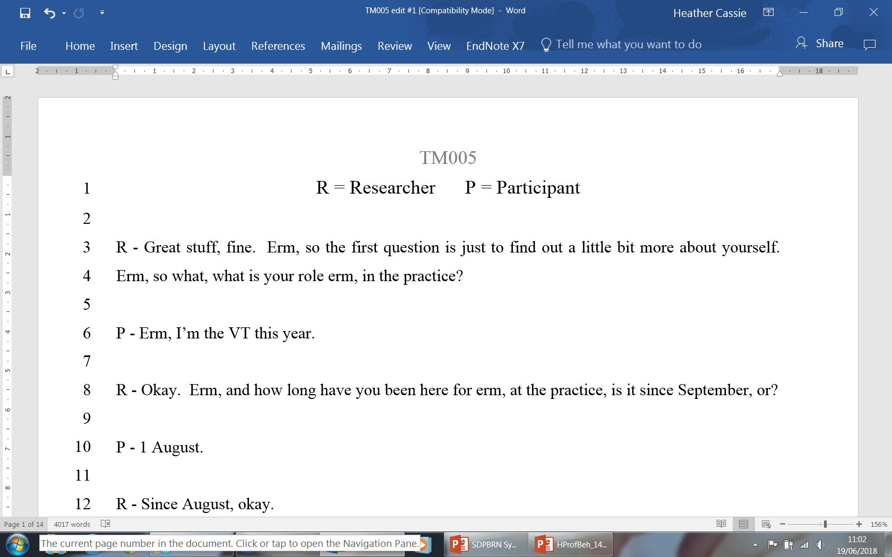
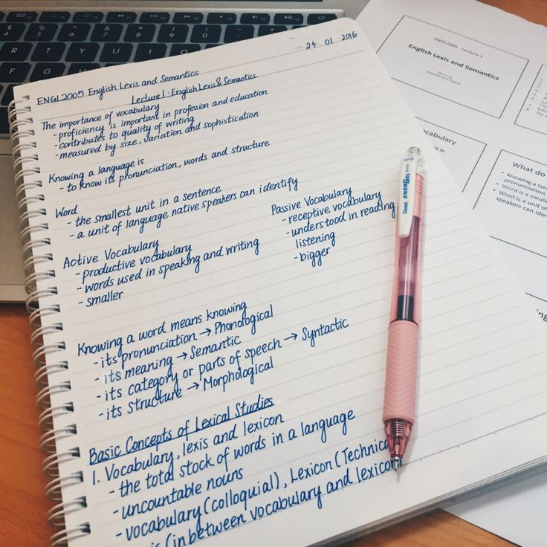

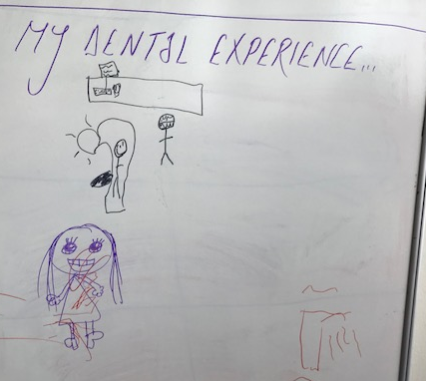
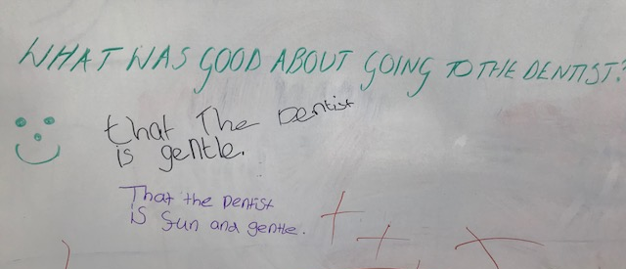
Types of Qualitative Data

Slide 8


Slide 9

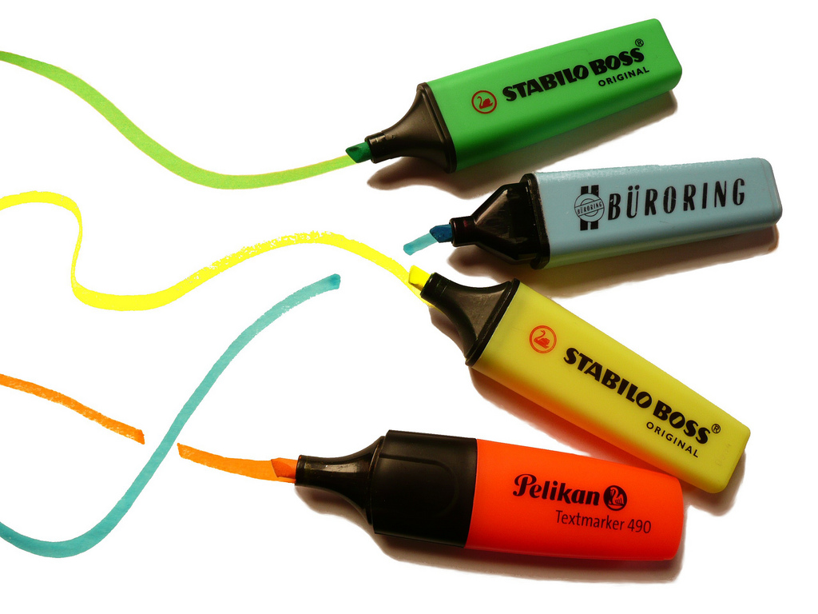
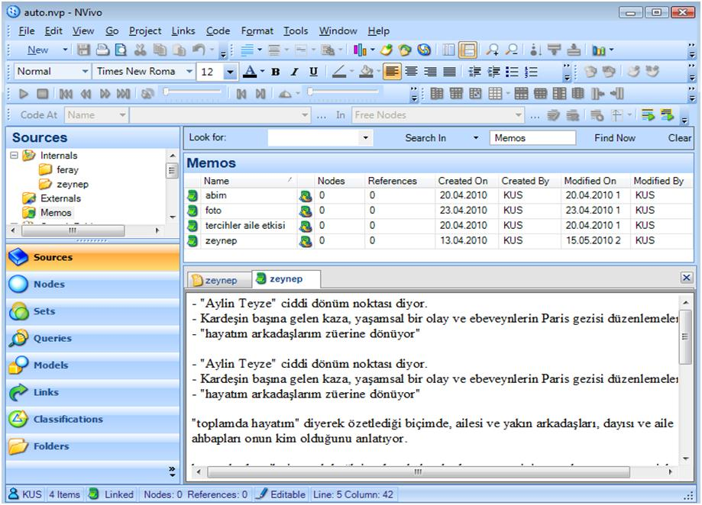
Managing Qualitative Data

Slide 10

Methods of Analysis
Grounded theory
Theory-based content analysis
Realist synthesis
Framework analysis
Thematic analysis

Slide 11
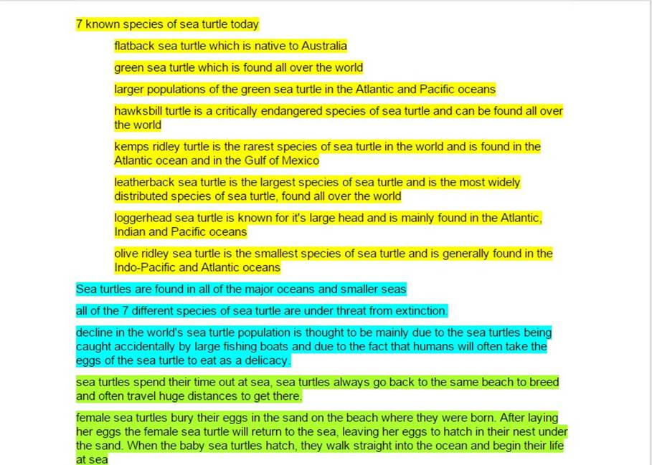
Thematic Analysis
Categorise data according to themes and sub-themes
Can either start with a pre-defined framework (headings) or allow the themes to emerge from the data
May involve identifying the barriers/ facilitators to carrying out a specific behaviour

Slide 12
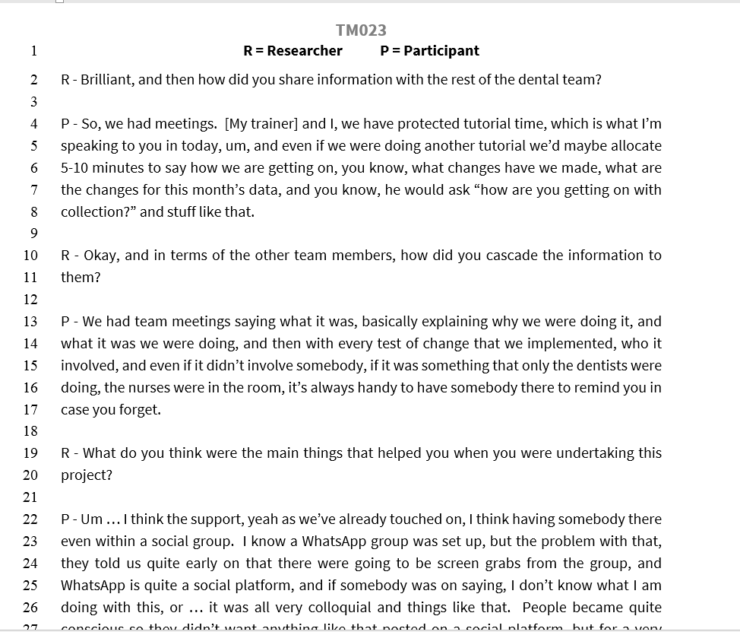

Over to you…
Work in teams
Read through the interview
transcript provided
Using the highlighters identify
the barriers and facilitators to:
‘Carrying out a QI project in practice’
As a group, discuss your coding and arrange the barriers and facilitators into categories
(e.g. team work, leadership, communication)

Slide 13

Group Feedback

Slide 14

Take home messages
Analysing qualitative data is subjective
A clear and transparent approach is crucial
Good to work in teams or double code
Its not difficult!

Slide 15


Any Questions?
Heather Cassie
h.c.cassie@dundee.ac.uk

